Slide 1
IDENTIFYING DRIVERS OF OUTCOMES
Dr. Ceren Kolsarici

Slide 2

Agenda for This Session
Mathematical Exposition of ML
Assessing Model Accuracy
Identifying Drivers of Outcomes (Theory + Application)
Bayesian Approach to Linear Regression (Theory + Application)
Hierarchical Linear Models (Theory + Application)

Slide 3
Mathematical exposition of SUPERVISED learning

Slide 4
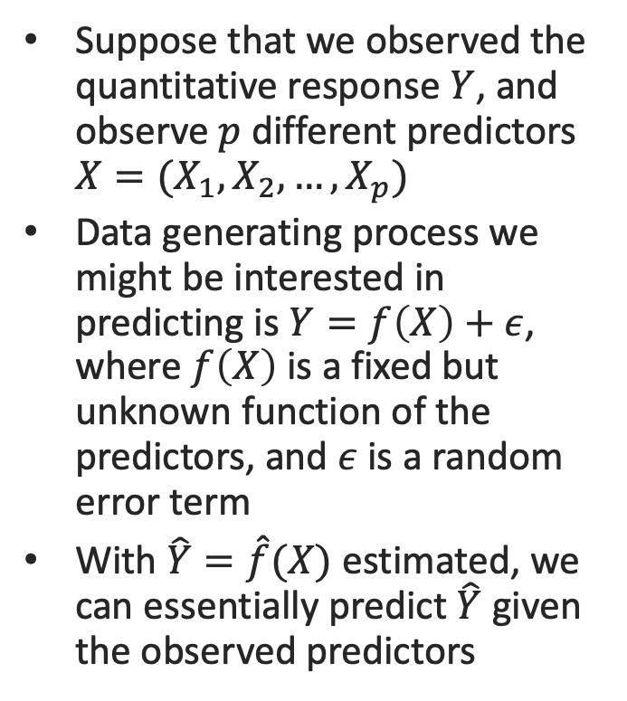
A Typical Data Generating Process
Suppose that we observed the quantitative response $Y$, and observe $p$ different predictors $X=(X_{1},X_{2},…,X_{p})$
Data generating process we might be interested in predicting is $Y=f\left(X\right)+ε$, where $f\left(X\right)$ is a fixed but unknown function of the predictors, and $ε$ is a random error term
With $\hat{Y}=\hat{f}(X)$ estimated, we can essentially predict $\hat{Y}$ given the observed predictors

Slide 5
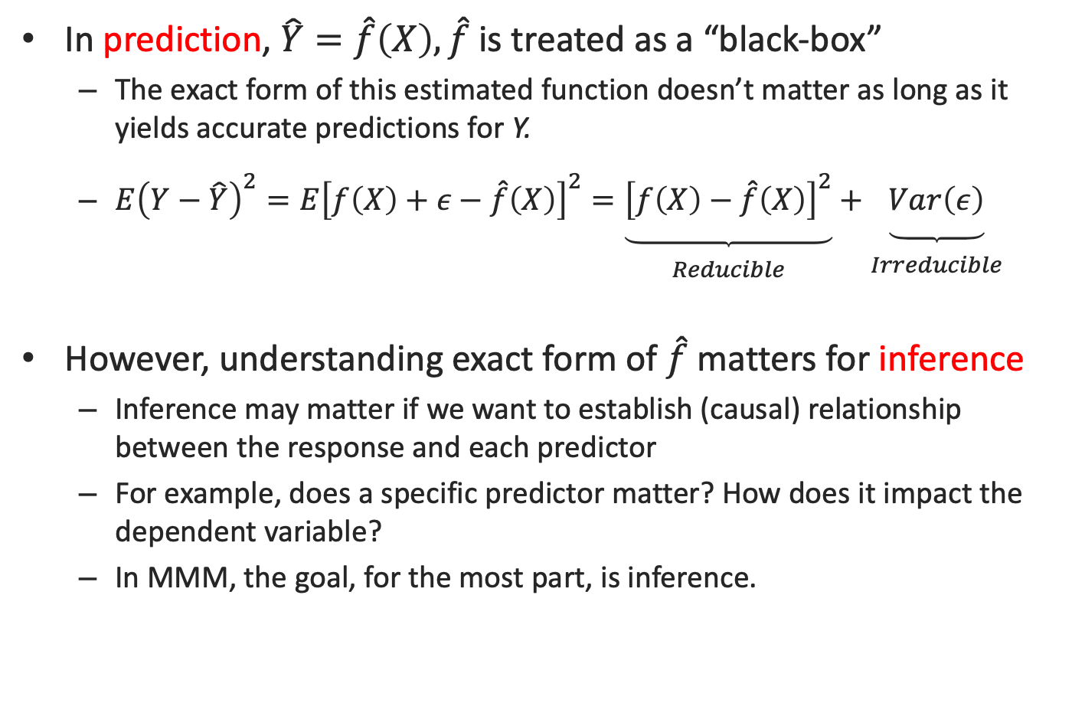
Why estimate $f$? Prediction vs Inference
In prediction, $\hat{Y}=\hat{f}\left(X\right),\hat{f}$ is treated as a “black-box”
The exact form of this estimated function doesn’t matter as long as it yields accurate predictions for Y.
$E{\left(Y−\hat{Y}\right)}^{2}=E{\left[f\left(X\right)+ε−\hat{f}\left(X\right)\right]}^{2}=\underset{\begin{aligned} \\ Reducible\end{aligned}}{\underbrace{{\left[f\left(X\right)−\hat{f}\left(X\right)\right]}^{2}}}+\underset{\begin{aligned} \\ Irreducible\end{aligned}}{\underbrace{Var\left(ε\right)}}$
However, understanding exact form of $\hat{f}$ matters for inference
Inference may matter if we want to establish (causal) relationship between the response and each predictor
For example, does a specific predictor matter? How does it impact the dependent variable?
In MMM, the goal, for the most part, is inference.
Notes:
We estimate f with the aim of minimizing the reducible error. It is important to keep in mind that the irreducible error will always provide an upper bound on the accuracy of our prediction for Y.

Slide 6

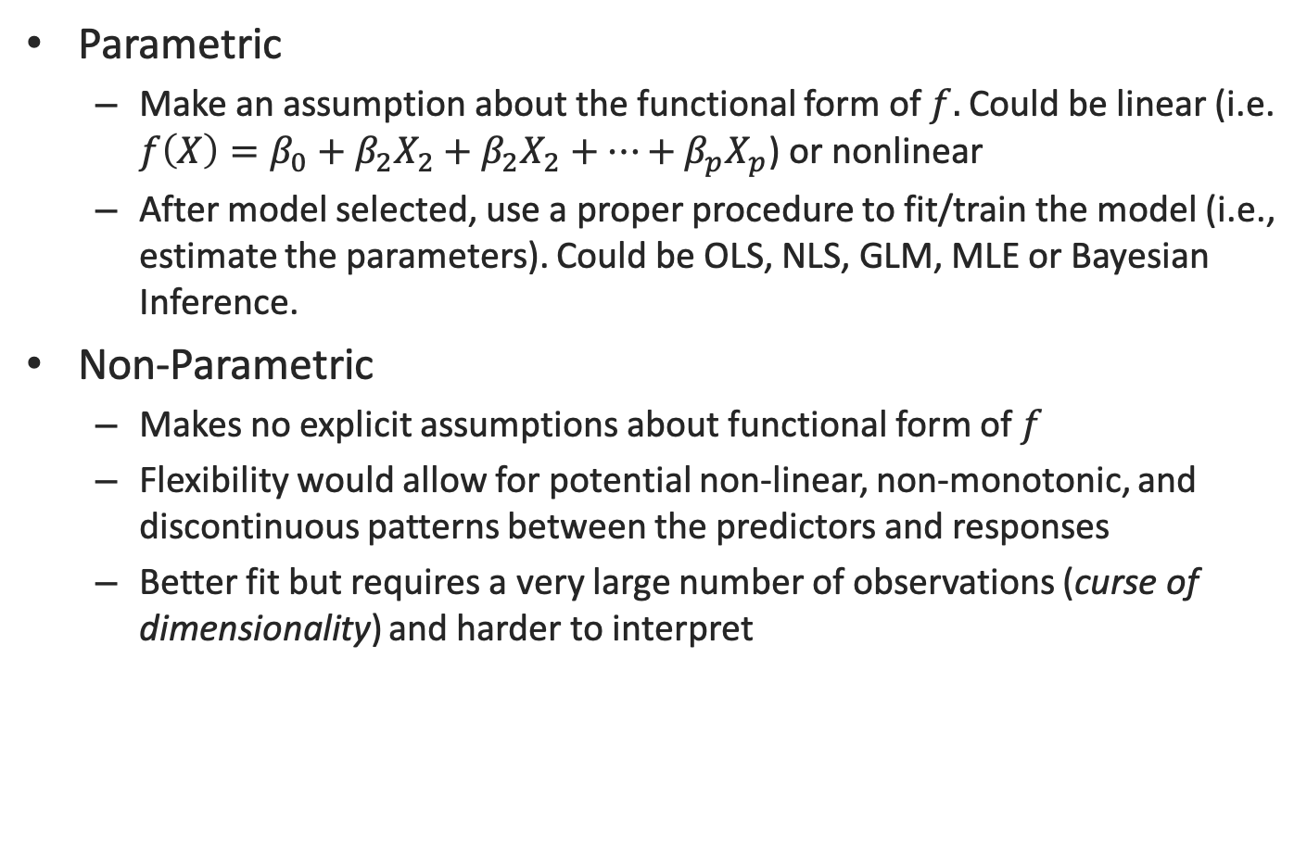
How to Estimate $f$?
Parametric
Make an assumption about the functional form of $f.$ Could be linear (i.e. $f\left(X\right)=β_{0}+β_{2}X_{2}+β_{2}X_{2}+…+β_{p}X_{p}$) or nonlinear
After model selected, use a proper procedure to fit/train the model (i.e., estimate the parameters). Could be OLS, NLS, GLM, MLE or Bayesian Inference.
Non-Parametric
Makes no explicit assumptions about functional form of $f$
Flexibility would allow for potential non-linear, non-monotonic, and discontinuous patterns between the predictors and responses
Better fit but requires a very large number of observations (curse of dimensionality) and harder to interpret

Slide 7
Model Fit Visualization:
Linear Model
Spline Model (smooth)
Spline Model
(more flexible)
What’s the catch?

Slide 8
Flexibility vs. Interpretability
Parametric Regression
Non-parametric Regression
If the assumed functional form/error term assumptions are correct:
Consistency ☺
Asymptotic efficiency ☺
High degree of uncertainty regarding the functional form
Inflexibility ☹
Bias ☹
Inconsistency ☹
Imposes few restrictions on the form of the joint distribution of the data:
Flexibility ☺
Consistency with less restrictive conditions ☺
Convergence rate is much slower
Inefficiency ☹
Need for large data sets ☹
Three major types:
Kernel estimators
K-nearest neighbor estimators
Spline regression estimators
However!
Incorrect specifications lead to incorrect inferences.
In MMM, try alternative specifications and validate/benchmark rigorously.
Notes:
Consistency: Estimates converge to true values as the sample size→ infinity
Asy.eff: The rate of convergence is maximal.
Non-parametric: the relationship between criterion variable and predictors are formed without any reference to a specific form.
Flexibility→ allowance for flexible interactions
Consistency → Non-normal errors, heteroskedasticity and nonlinearity are automatically accounted for.
#of dimensions inc. → required # of observations inc.

Slide 9
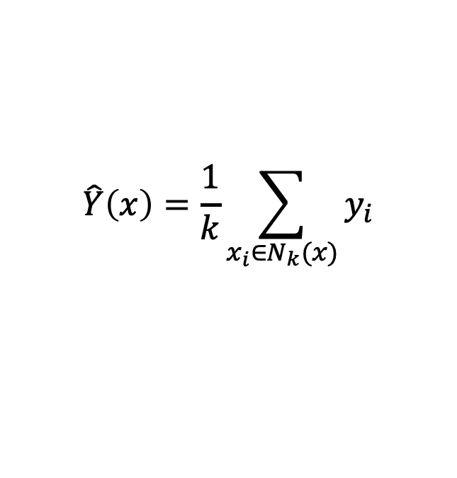
K-Nearest Neighborhood
As the neighborhood (k) gets bigger:
the variance decreases
the bias increases
k=6
$$\hat{Y}\left(x\right)=\frac{1}{k}\sum_{x_{i}∈N_{k}(x)}{y_{i}}$$

Slide 10

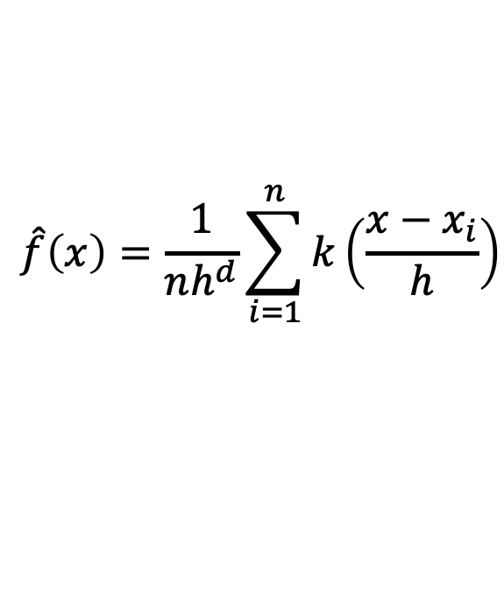
Kernel Estimation
As the bandwidth (h) gets bigger:
the variance decreases
the bias increases
$$\hat{f}\left(x\right)=\frac{1}{nh^{d}}\sum_{i=1}^{n}{k\left(\frac{x−x_{i}}{h}\right)}$$
Bandwidth (constant, or adaptive)
Conditional pdf
Kernel Function
Number of dimensions of $x$
Kernel Regression
Estimate $y$ locally as a weighted average, using kernel weighing function
Notes:
F(x,y) → joint density, F(x) → marginal density. Rather than give all points equal weights we can assign weights that die off smoothly with distance from the target point. → Kernel method: local weighted average of the criterion y, given the predictors x0.

Slide 11
Issue 1
Typically non-parametric methods rely heavily on the geometric concept of Euclidean Space. When the number of variables increases, so does the dimensionality of the space, leading to sparsely populated neighborhoods.
The required number of data points for reliable estimation explode with increasing number of variables
CURSE OF DIMENSIONALITY

Slide 12
The Curse of Dimensionality
The degree of multicollinearity tends to increase with the number of dimensions
Possible interaction effects explode with each additional predictor
Number of predictors | Suggested Sample Sizes
 | Non-parametric model | Parametric model
1 | 4 | 5
2 | 19 | 10
3 | 67 | 15
4 | 223 | 20
5 | 768 | 25
6 | 2790 | 30
7 | 10700 | 35
8 | 43700 | 40
9 | 187000 | 45
10 | 842000 | 50

Slide 13
ISSUE 2: Bias-Variance Trade Off
Bias-variance trade off and overfitting is mainly an issue in test samples (out of sample forecasting).
High Bias
Low Variance
Low Bias
High Variance
Overfitting
Test Sample
Prediction Error
Training Sample
Model Complexity
Low
High
$$E{\left(Y−\hat{Y}\right)}^{2}=Var\left(\hat{f}\left(X\right)\right)+{\left[Bias\left(\hat{f}\left(X\right)\right)\right]}^{2}+Var(ε)$$

Slide 14
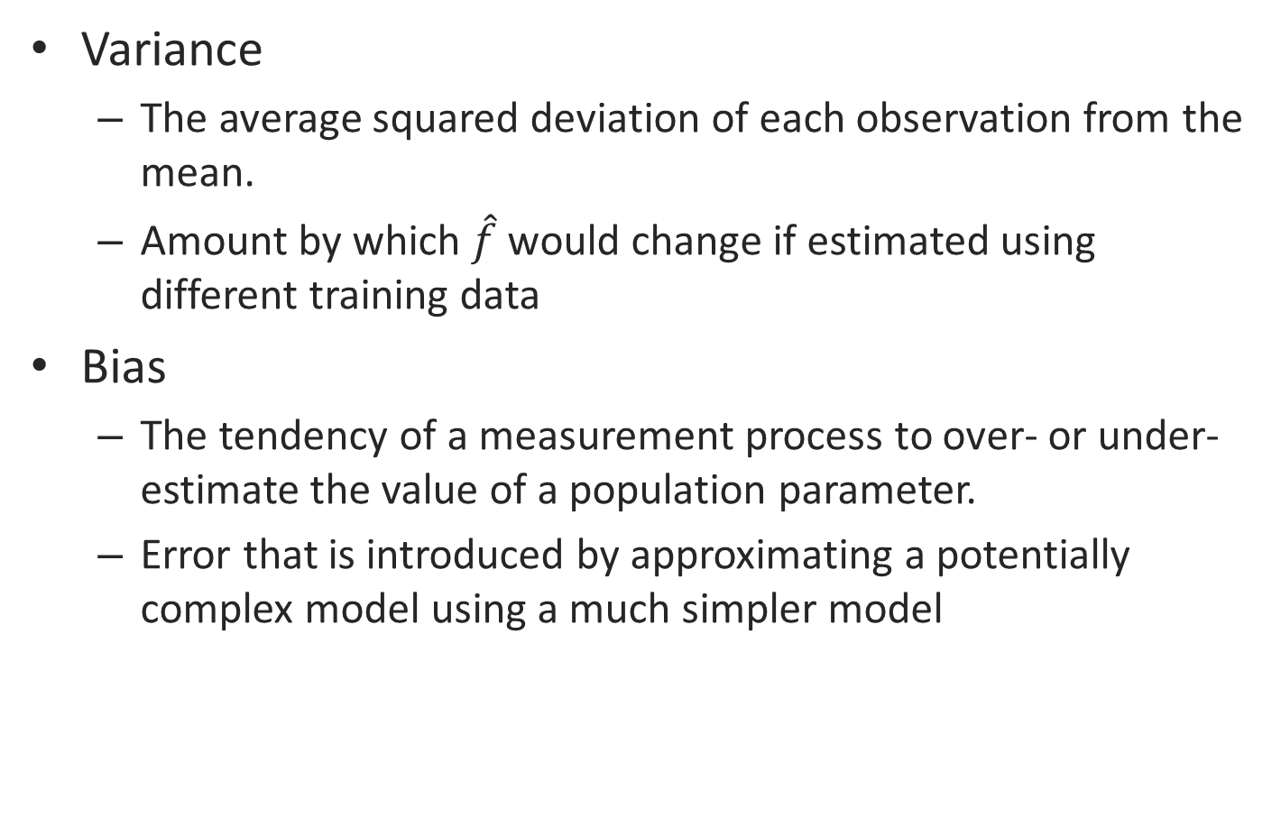
Bias and Variance Defined
Variance
The average squared deviation of each observation from the mean.
Amount by which $\hat{f}$ would change if estimated using different training data
Bias
The tendency of a measurement process to over- or under-estimate the value of a population parameter.
Error that is introduced by approximating a potentially complex model using a much simpler model
$$E{\left(Y−\hat{Y}\right)}^{2}=Var\left(\hat{f}\left(X\right)\right)+{\left[Bias\left(\hat{f}\left(X\right)\right)\right]}^{2}+Var(ε)$$

Slide 15
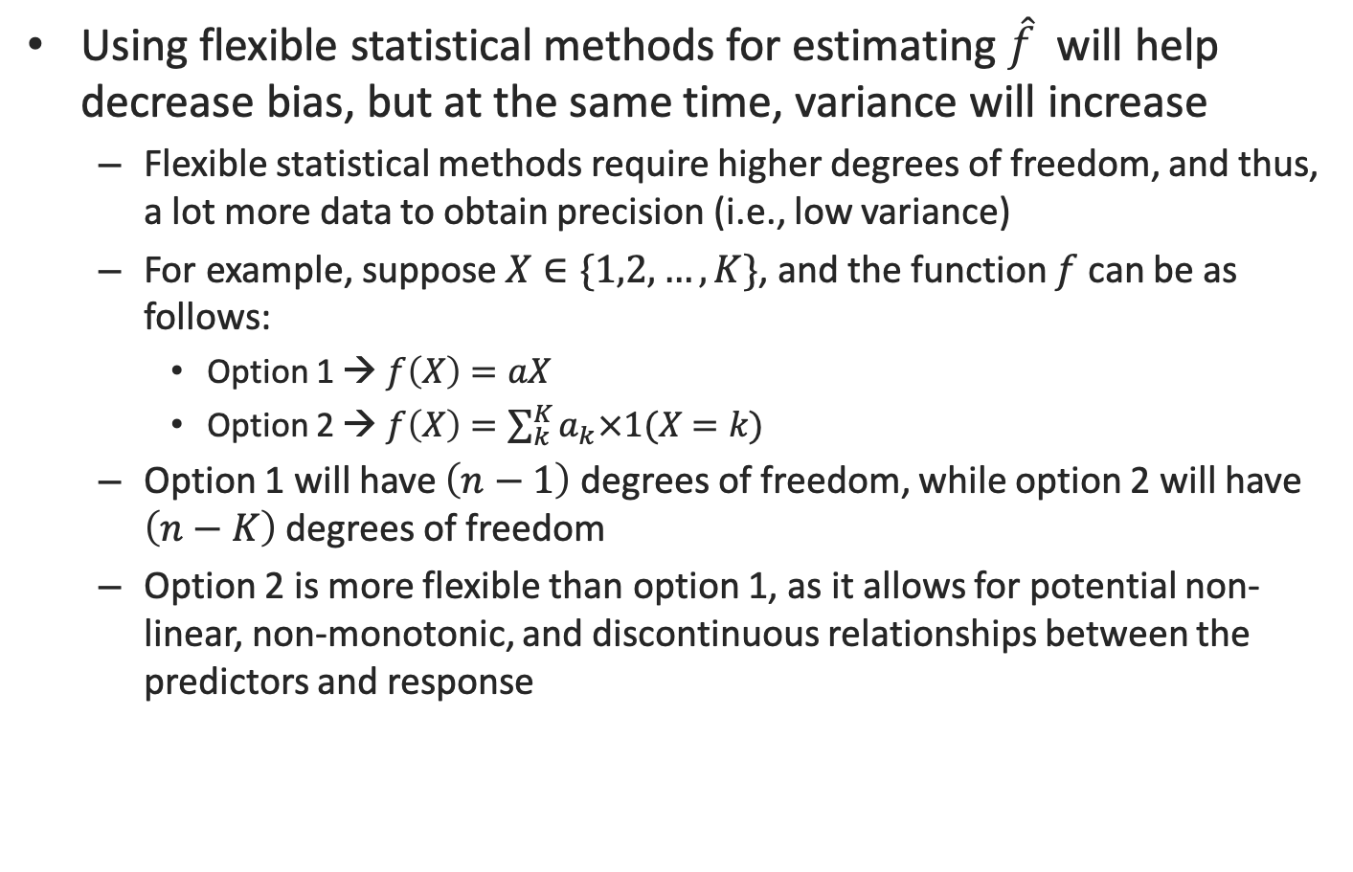
Why is there a Trade-Off?
Using flexible statistical methods for estimating $\hat{f}$ will help decrease bias, but at the same time, variance will increase
Flexible statistical methods require higher degrees of freedom, and thus, a lot more data to obtain precision (i.e., low variance)
For example, suppose $X∈\{1,2,…,K\}$, and the function $f$ can be as follows:
Option 1 → $f\left(X\right)=aX$
Option 2 → $f\left(X\right)=\sum_{k}^{K}{a_{k}×1(X=k)}$
Option 1 will have $\left(n−1\right)$ degrees of freedom, while option 2 will have $\left(n−K\right)$ degrees of freedom
Option 2 is more flexible than option 1, as it allows for potential non-linear, non-monotonic, and discontinuous relationships between the predictors and response

Slide 16
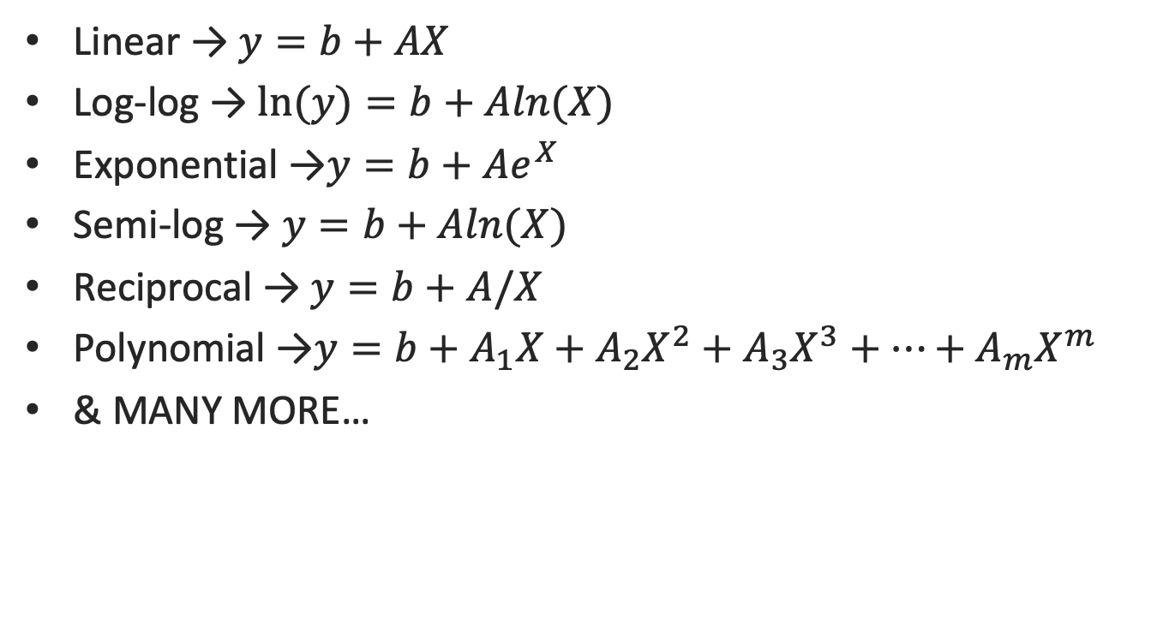
ISSUE 3: Selection Bias/Misspecification
Some possible parametric specifications
Linear → $y=b+AX$
Log-log → $ln(y)=b+Aln(X)$
Exponential →$y=b+Ae^{X}$
Semi-log → $y=b+Aln(X)$
Reciprocal → $y=b+A/X$
Polynomial →$y=b+A_{1}X+A_{2}X^{2}+A_{3}X^{3}+…+A_{m}X^{m}$
& MANY MORE…
X`=(X₁,X₂,…,X_{k})
Vector of Predictor Variables
For 3 parameters, # of alternative models
>91

Slide 17
How to Compare Algorithms?
Subset Selection
LASSO
High
Least Squares
Generalized Additive Models
Trees
Interpretability
Bagging
Boosting
Support Vector Machines
Low
Low
High
Flexibility

Slide 18
ASSESSING MODEL ACCURACY

Slide 19
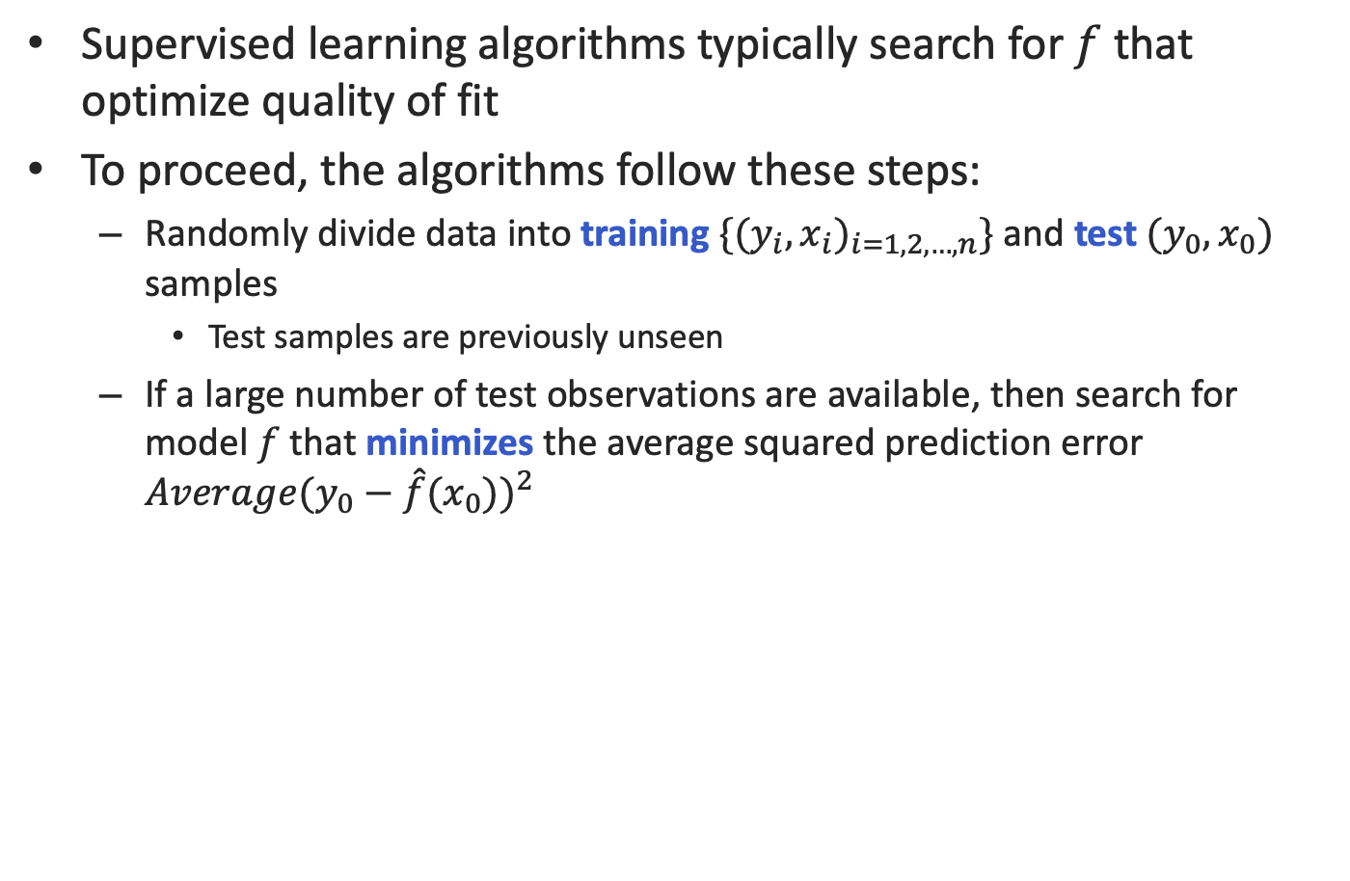
Measuring Quality of Fit
Supervised learning algorithms typically search for $f$ that optimize quality of fit
To proceed, the algorithms follow these steps:
Randomly divide data into training ${\{(y_{i},x_{i})}_{i=1,2,…,n}\}$ and test $(y_{0},x_{0})$ samples
Test samples are previously unseen
If a large number of test observations are available, then search for model $f$ that minimizes the average squared prediction error $Average{(y_{0}−\hat{f}(x_{0}))}^{2}$

Slide 20
Basic Idea of ML: Step #1
Training
Data
Testing

Slide 21




Basic Idea of ML: Step #2
Training
$$f_{1}$$
$$f_{2}$$
Training sample outcome
$${\hat{f}}_{2}$$
Training sample predictor
$${\hat{f}}_{1}$$
Testing sample outcome
Testing
Testing sample predictor

Slide 22



Basic Idea of ML: Step #3
In the test sample
Fit
Fit
$${\hat{f}}_{1}$$
$${\hat{f}}_{2}$$
VS

Slide 23
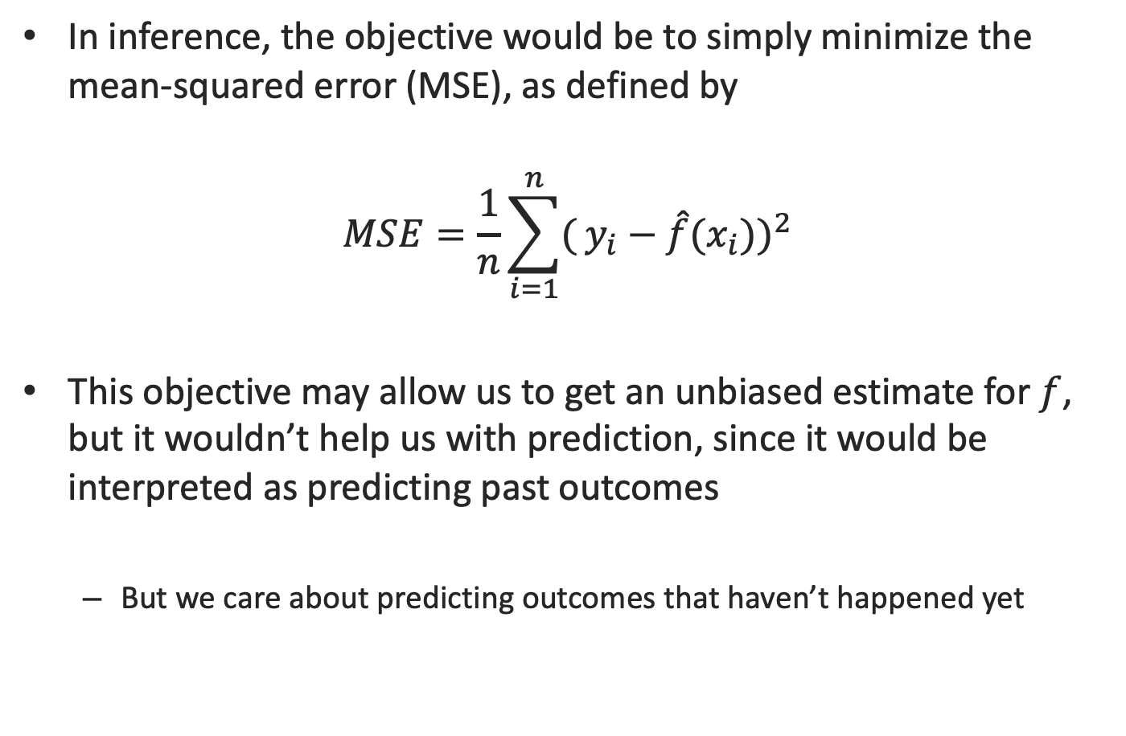
Difference from Inference
In inference, the objective would be to simply minimize the mean-squared error (MSE), as defined by
$$MSE=\frac{1}{n}\sum_{i=1}^{n}{(}{y_{i}−\hat{f}(x_{i}))}^{2}$$
This objective may allow us to get an unbiased estimate for $f$, but it wouldn’t help us with prediction, since it would be interpreted as predicting past outcomes
But we care about predicting outcomes that haven’t happened yet

Slide 24
Identifying drivers of outcomes
Linear Regression, Model Fit and Hold-out Prediction

Slide 25
Amusement Park Data
Results from a survey of visitors to an amusement park
Objective measures: whether the respondent visited on a weekend (weekend), the number of children brought (num.child), and distance traveled to the park (distance)
Subjective measures of satisfaction: expressed satisfaction overall (overall) and satisfaction with the rides, games, waiting time, and cleanliness (rides, games, wait, and clean, respectively)
Goal: Understand the drivers of consumer satisfaction

Slide 26
Linear Regression Steps
Eyeballing the data!
Basic visualizations
Pattern recognition (e.g. distributions of variables, correlation patterns)
Summary statistics
Multi-collinearity?
Check for violations of assumptions
Linearity and additivity
Statistical independence of errors (i.e. no correlation between consecutive errors)
Homoscedasticity (i.e. constant variance of errors)
Normality of the errors
Why are these preliminary steps important?
If any of these assumptions is violated, then the forecasts, confidence intervals, and scientific insights yielded by a regression model may be (at best) inefficient or (at worst) seriously biased or misleading.

Slide 27
Modeling Steps – 1
Preliminary Data Inspection
General descriptive statistics: summary(sat.df)
Generalized pair plots: gpairs(sat.df)
Any concerns? (e.g. non-normal variables, high correlations across certain pairs)
Look further into correlations:
corrplot.mixed(cor(sat.df[ , c(2, 4:9)]), upper="ellipse")
Linear model with a single predictor
m1 <- lm(overall ∼ rides, data=sat.df)
plot(overall ∼ rides, data=sat.df, xlab="Satisfaction with Rides", ylab="Overall Satisfaction")
abline(m1, col='blue'), str(m1)
Checking model fit
Plot(m1$fitted.values,m1$residuals)
Plot(m1)

Slide 28
Pair Plots
What do we see?

Slide 29
Correlation Patterns
Interpretation?
Extreme correlations between items (r>0.85) need to be addressed before modelling
In the amusement park data, none of the variables seem to be nearly identical

Slide 30
Model Fit
Linear model with a single predictor
Overall = -94.962 + 1.703*Rides

Slide 31
Checking for Model Assumptions
par(mfrow=c(2,2))
plot(m1)
Observations:
No pattern btw fitted values and residuals (i.e. random residuals)
Outliers are flagged with obs. Numbers for further investigation
Residuals are normally distributed (see the Q-Q plot)
No sign of non-linear relationship

Slide 32
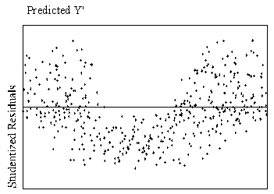
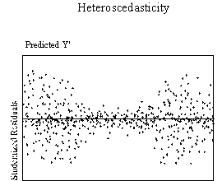
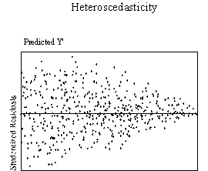
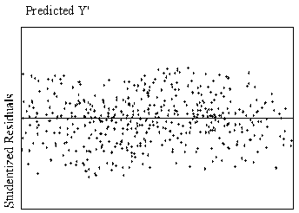
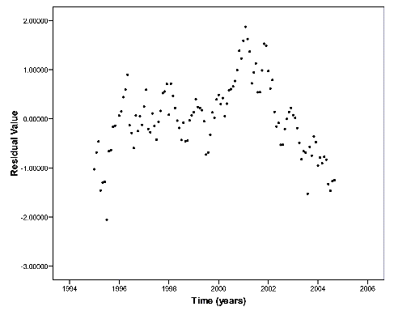
Examples of Violations
Nonlinearity | Autocorrelated Errors
Heteroskedasticity | Heteroskedasticity

Slide 33
Modeling Steps – 2
Linear models with multiple predictors
> m2 <- lm(overall ∼ rides + games + wait + clean, data=sat.df)
> summary(m2)
Visualize coefficients
> library(coefplot) # install if necessary
> coefplot(m2, intercept=FALSE, outerCI=1.96, lwdOuter=1.5,
+ ylab="Rating of Feature", xlab="Association with Overall Satisfaction")

Slide 34
Comparing Different Drivers
Comparison across "coefficient" values is only plausible for standardized data or similar scales
sat.std <- sat.df[ , -3] # sat but remove distance
sat.std[ , 3:8] <- scale(sat.std[ , 3:8])
Otherwise, t-values should be used for comparing impact levels across drivers

Slide 35
Model Selection
Criteria for picking the best model
In-sample fit:
R-squared, adjusted R-squared, predicted vs. actual plots, ANOVA
Hold-out prediction
PredictTest <- Predict(m2, sat.dfTest)
# Compute R-squared
SSE = sum((sat.dfTest$Overall - predictTest)^2)
SST = sum((sat.dfTest$Overall - mean(sat.df$Overall))^2)
Rsq=1 - SSE/SST

Slide 36
Fitted versus Actual Scatter Plots
> plot(sat.df$overall, fitted(m1), col='red', xlim=c(0,100), ylim=c(0,100), xlab="Actual Overall Satisfaction", +ylab="Fitted Overall Satisfaction")
> points(sat.df$overall, fitted(m2), col='blue')
> legend("topleft", legend=c("model 1", "model 2"),
+ col=c("red", "blue"), pch=1)
Model 2 is reasonable but can we improve it?

Slide 37
Interaction Terms and Dummy Variables
Often we need to transform categorical variables into numeric forms before integrating into the model.
For example, weekend: Yes, No will be transformed into 1,0
In general, a categorical variable with n levels will be transformed into (n-1) dummy variables
(e.g. in R sat.std$num.child.factor <- factor(sat.std$num.child))
Alternatively, we can group multiple levels of a categorical variable together
(e.g. in R sat.std$has.child <- factor(sat.std$num.child > 0))
We might want to investigate if one variable effects the influence of another variable via interaction terms.
lm(overall ∼ rides + games + wait + clean + weekend + logdist + has.child + rides:has.child + games:has.child + wait:has.child + clean:has.child + rides:weekend + games:weekend + wait:weekend + clean:weekend, data=sat.std)

Slide 38
Syntax for Interaction Terms in R

Slide 39
Caution! Overfitting
Adding more variables, despite increasing fit, does not lead to a better model and looses its generalizability.
This process of adding too many variables and ending up with a less precise or inappropriate model is called overfitting.
Less precise coefficient estimates (i.e. larger standard errors, narrower confidence intervals)
Lower hold-out prediction performance (i.e. less generalizability)
To avoid overfitting:
Keep a close eye on the standard errors for the coefficients; small standard errors are an indicator that there is sufficient data to estimate the model.
Select a subset of the data to hold out and not use to estimate the model. After fitting the model, use predict() on the hold out data and see how well it performs. Overfitted models will perform poorly when predicting outcomes for holdout data.

Slide 40
Key Takeaways From This Session
Before attempting any analysis, investigate the data, do eyeballing and understand what is going on.
Model building is an iterative process. We usually start with a simple model and add variables to make it more complex.
It is important to compare models at various stages and pick the simplest model that performs the best (i.e. favor parsimony over complexity)
To avoid overfitting, try to see how your model holds in a test sample.
This is also a test for how generalizable your model is

Slide 41
What Do We (Marketers) Do with These Results?
Identify several possible marketing interventions depending on our goal:
To increase overall satisfaction: Try to increase the number of visitors with children.
To appeal to visitors without children: Engage in further research to understand why their ratings are lower.
To assist allocating budget to personnel: the importance of cleanliness suggests continuing to allocate resources there.
We might also want to learn more about the association between children and waiting time, and whether there are things we could do to make waiting less frequent or more enjoyable.
When considering actions to take, it is especially important to remember that the model assesses association, not causation.
Possible changes in outcome should be viewed as hypotheses suggested by the model, to be confirmed separately.

